Slide 1
Welcome to the 2023 National Advanced Air Mobility Industry Forum

Slide 2
Thank You to Our Sponsors

Slide 3
Welcome Remarks
Representative Adam Holmes Chairman, Aviation and Aerospace Committee, Ohio House of Representatives

Slide 4
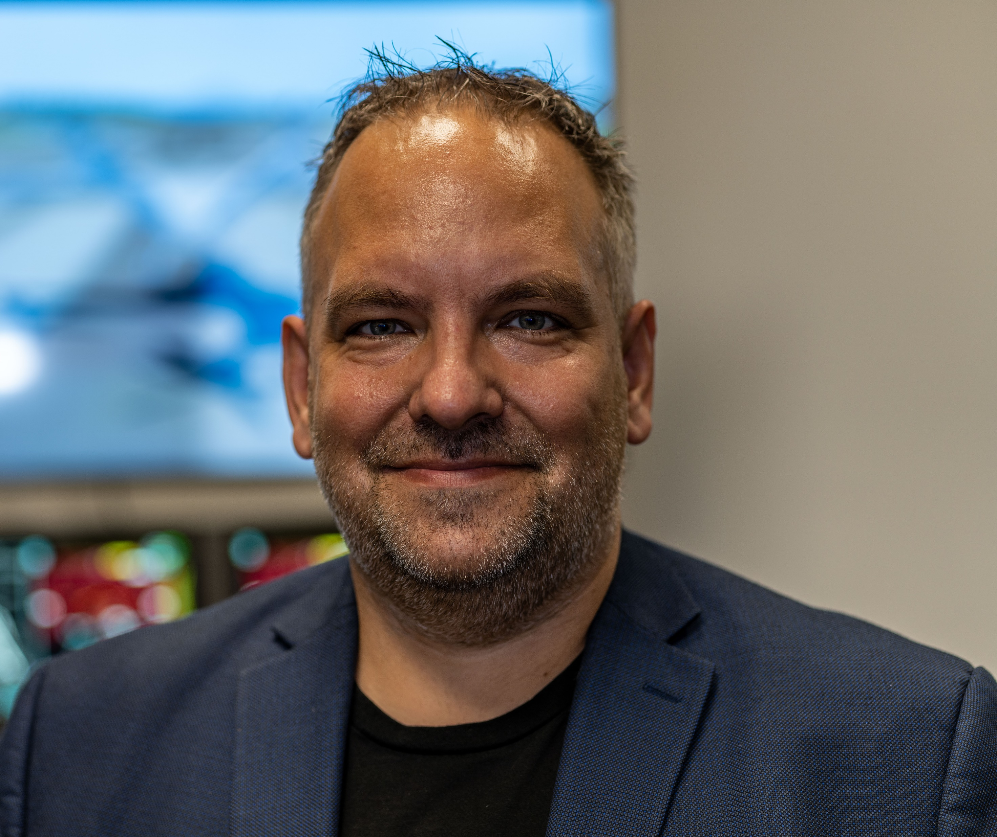
AAM Keynote
Mr. Greg Bowles Head of Government and Regulatory Affairs, Joby Aviation

Slide 5
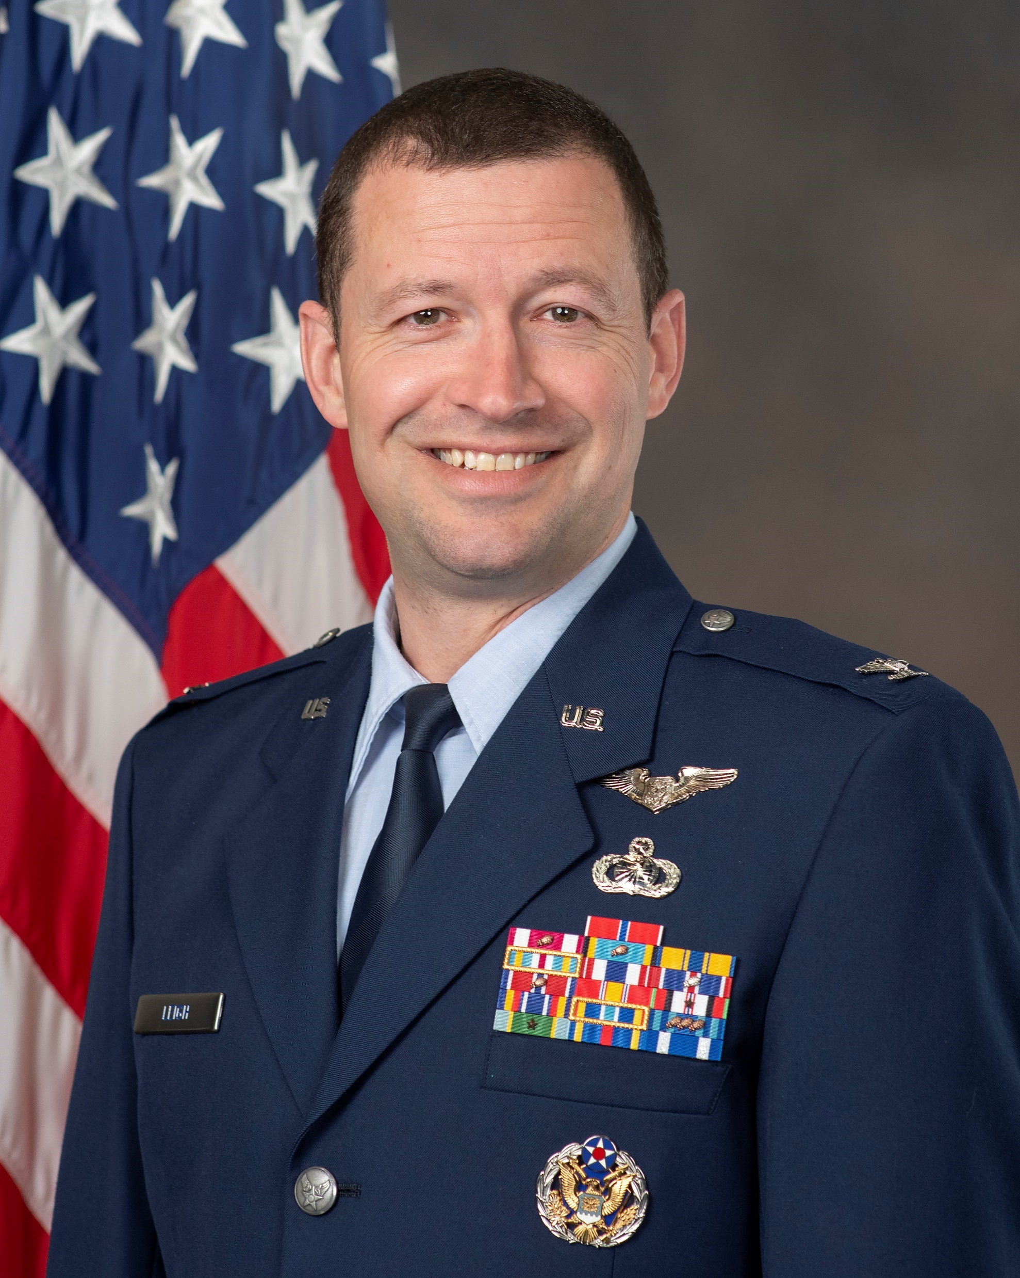
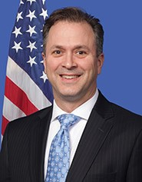
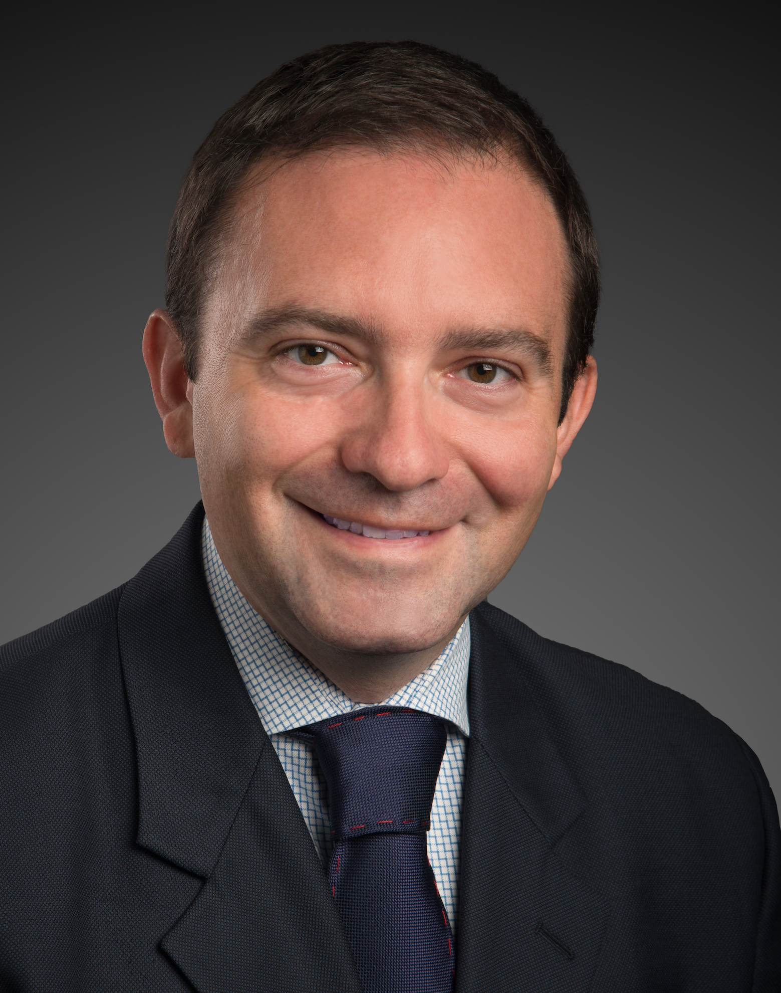
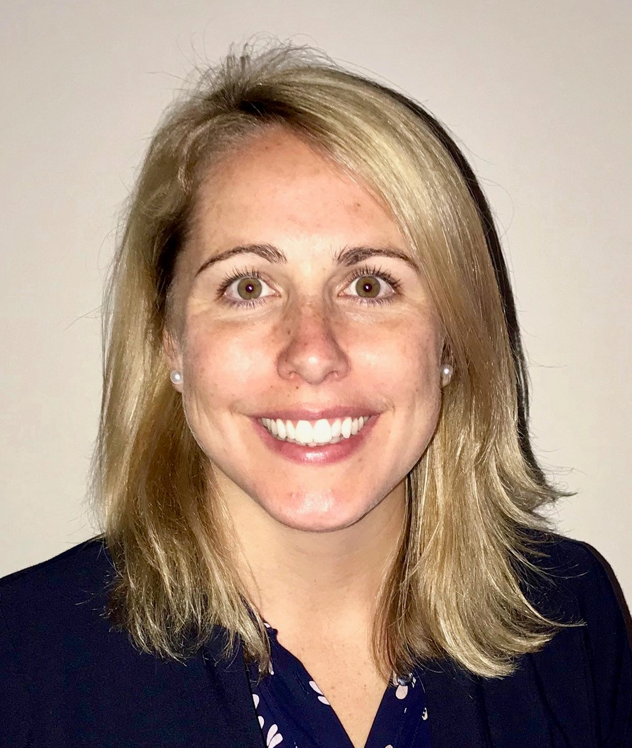
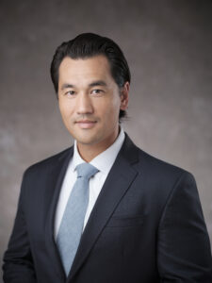
State of AAM Panel
Col Elliot “NEO” Leigh Director, AFWERX
Erik Amend Regional Administrator, Great Lakes Region, FAA
Sergio Cecutta Founding Partner, SMG Consulting
Megan Eisenstein Managing Director, Industry Affairs & Innovation, National Air Transportation Association (NATA)
David Dunning Director, Global Innovation & Policy, General Aviation Manufacturers Association (GAMA)

Slide 6
Program will resume in 15 minutes.
Networking Break

Slide 7
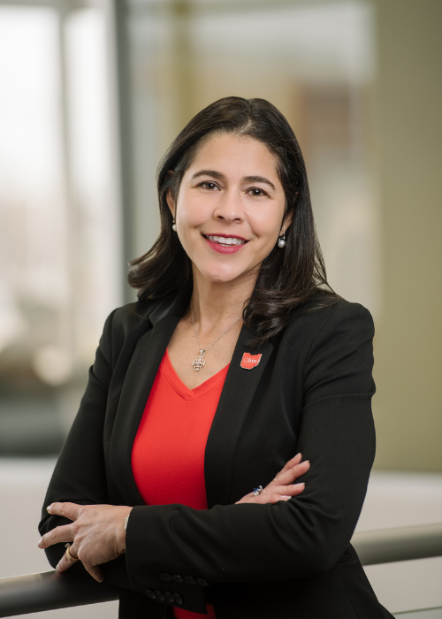
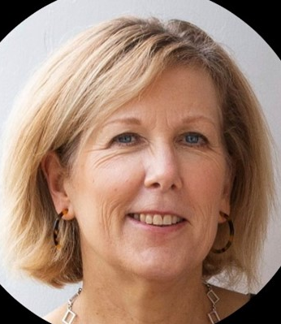
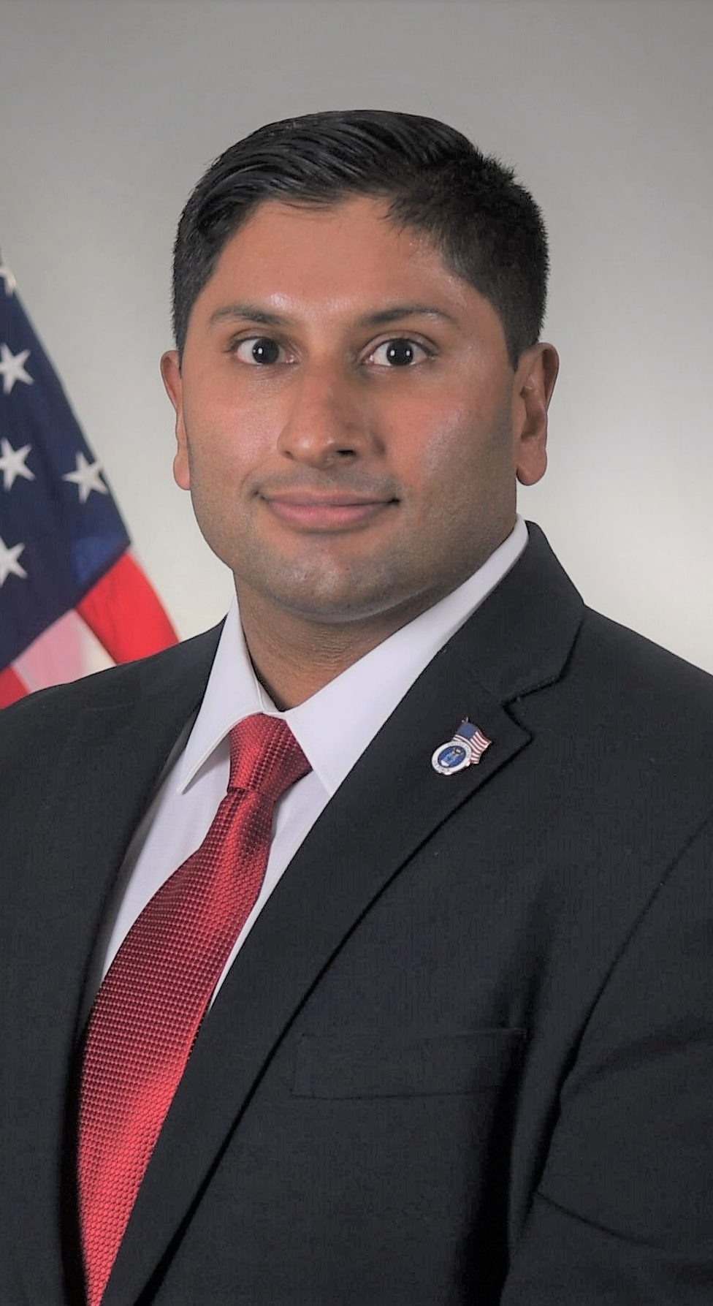
AAM Policy and Federal Partnerships Discussion
Elaine Bryant Executive Vice President, Aerospace & Defense, Dayton Development Coalition & Managing Director, Military & Federal, JobsOhio
Clare Doherty Vice President, Government Relations & Transportation Executive, FlightSafety International
Gerrit Everson Air Mobility Pathfinders (AMP) Vehicle Flight Test Team Lead, NASA AFRC
Dash Divakaran Head of Airspace Innovation & Prime Partnerships, AFWERX
Ryan Steinbach Aviation Policy Coordinator, US Department of Transportation
David Sizoo Flight Test Pilot, FAA

Slide 8
Program will resume at 12:00 PM.
Lunch Break

Slide 9
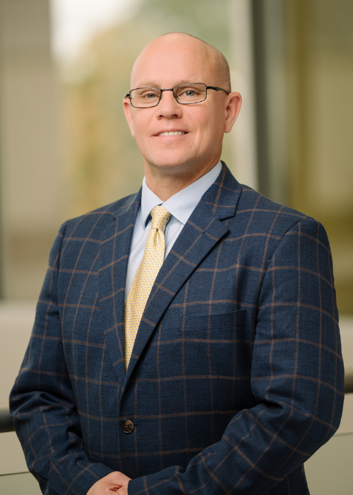
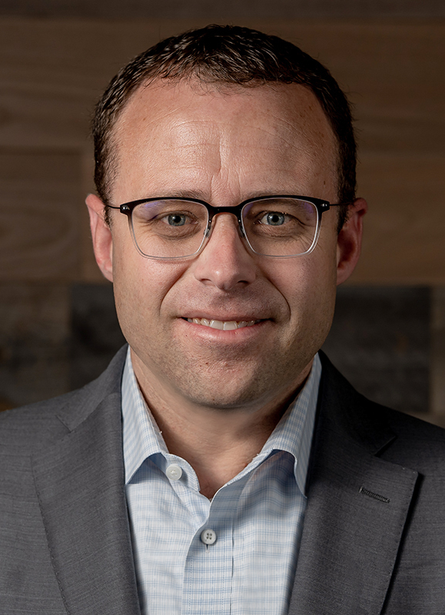
OEM Panel
Ted Angel Director, Aerospace Affairs, Dayton Development Coalition
Billy Nolen Chief Safety Officer, Archer Aviation
Scott O’Brien Legislative Affairs Specialist, Reliable Robotics
Jay Wakenshaw Chief Operating Officer, Elroy Air

Slide 10
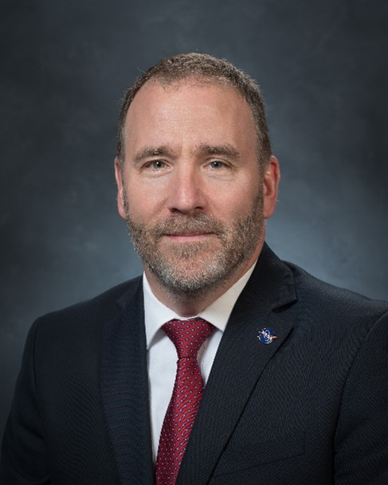
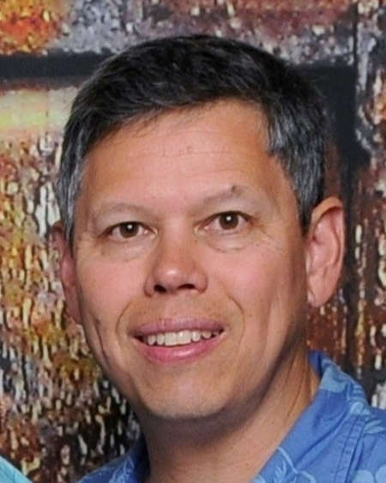
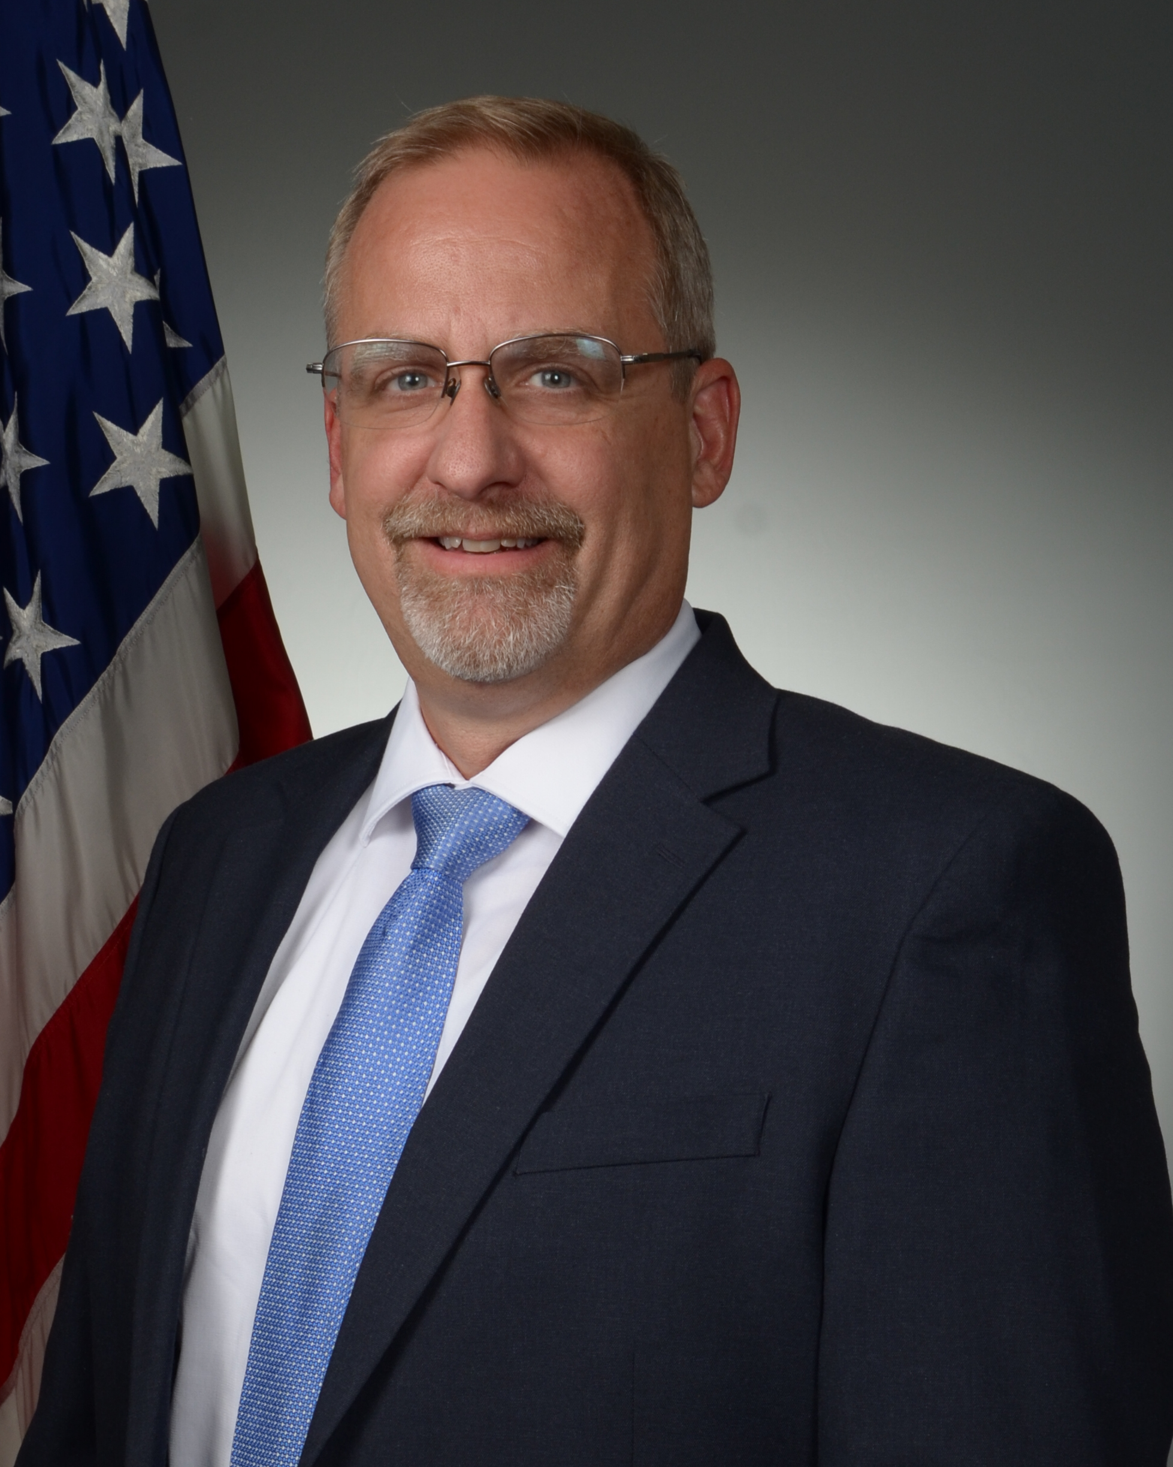
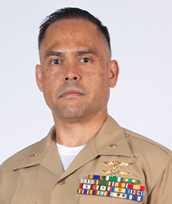
DoD Interests in AAM Panel
Tim McCartney Director, Aeronautics Research Directorate, NASA Glenn Research Center
George “Hog” Griffiths Airworthiness and Test Lead, AFWERX
Dr. Michael Gregg Director, Aerospace Systems Directorate, AFRL
Maj Brian “Tadpole” Heeter Aviation Department, HQ USMC

Slide 11
Program will resume in 15 minutes.
Networking Break

Slide 12
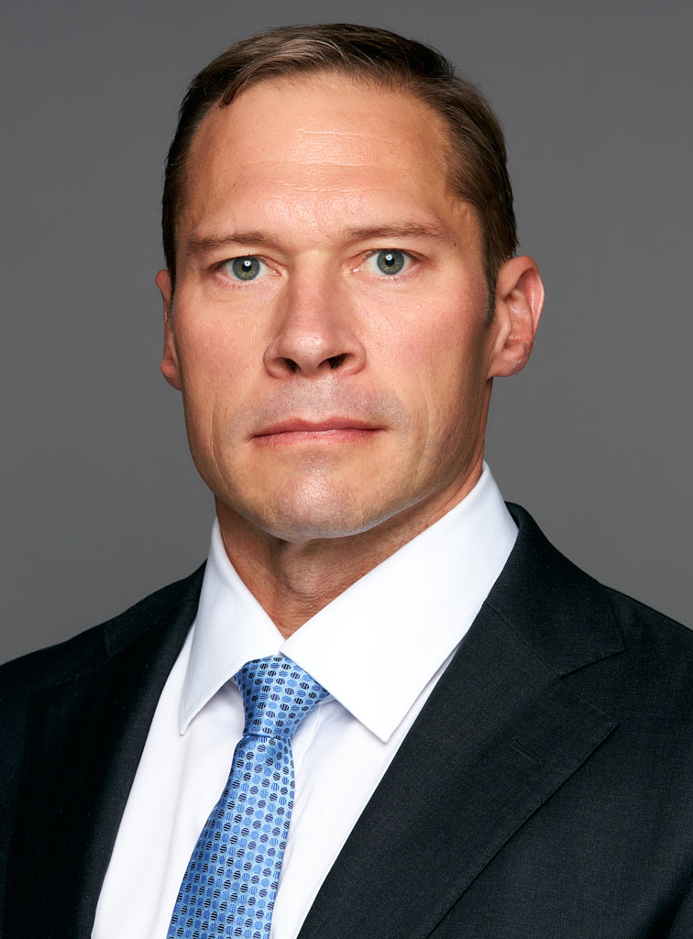
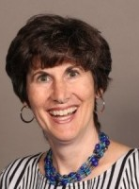
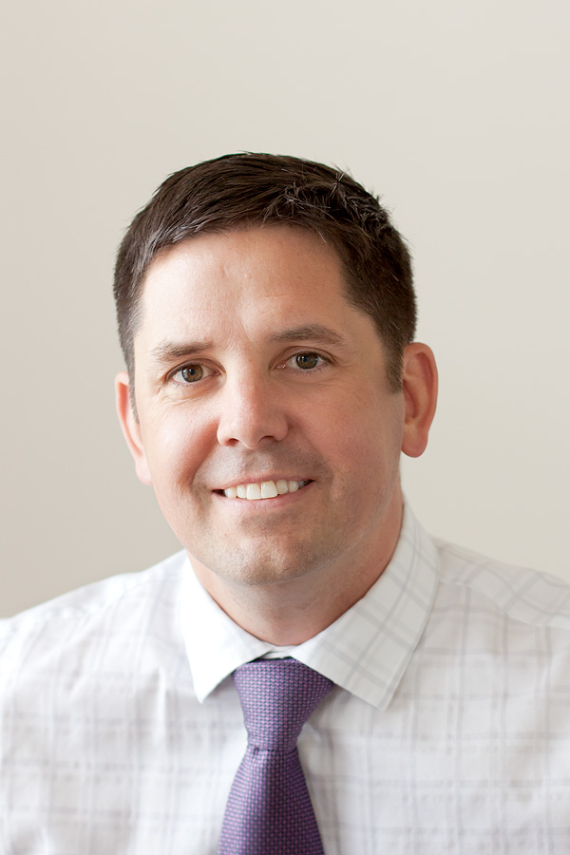
AAM Suppliers Panel
Dana Jensen Senior Industrial Policy Analyst, USAF
Stacy Biel Segment Manager, UAM, Military & Defense, Toray
Keven Gambold CEO, Unmanned Experts
Kevin Cain Chief Technology Officer, Aria Group

Slide 13
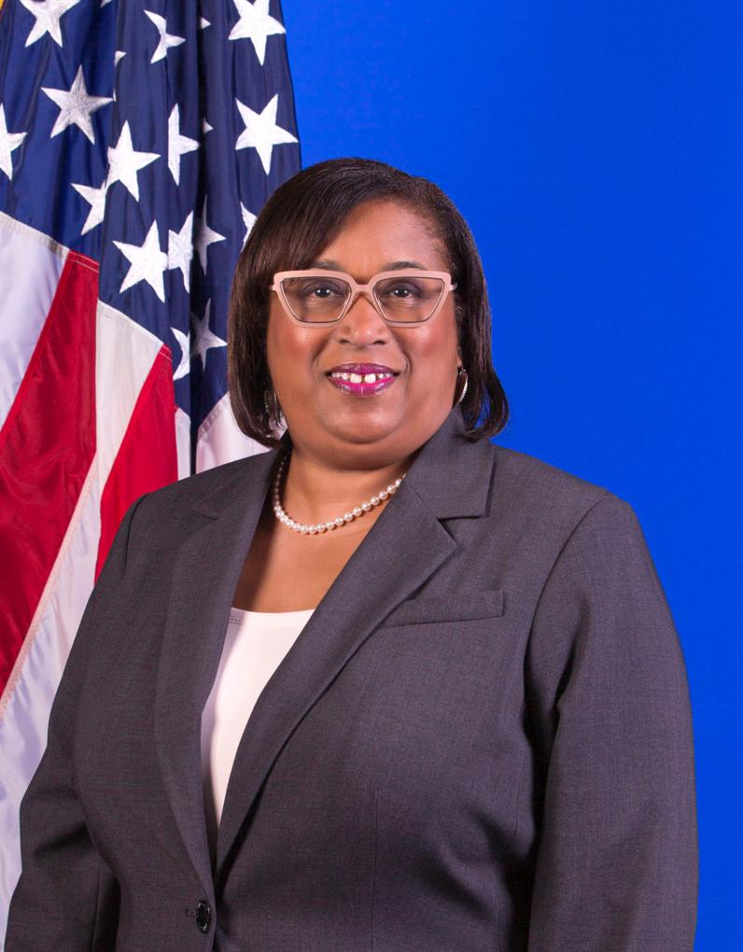
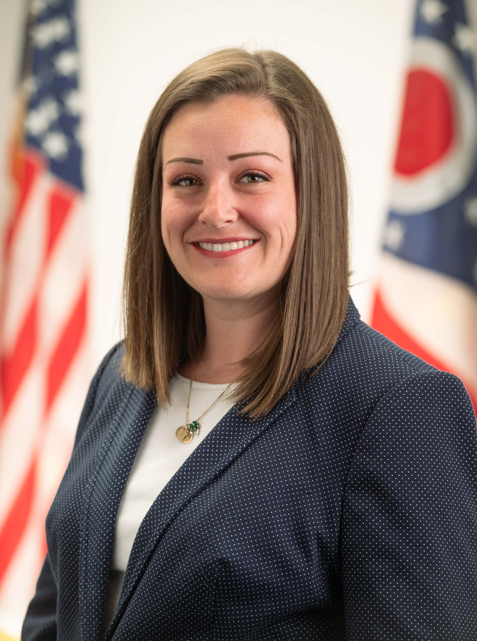
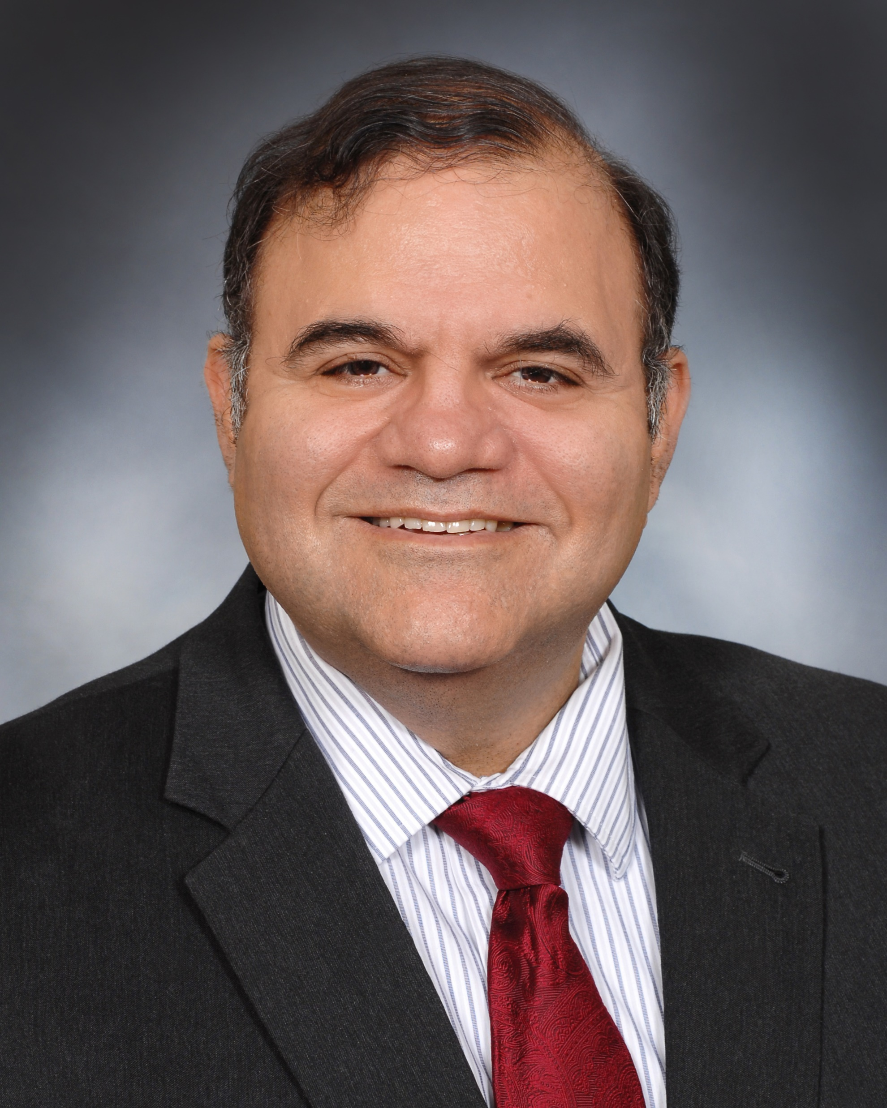
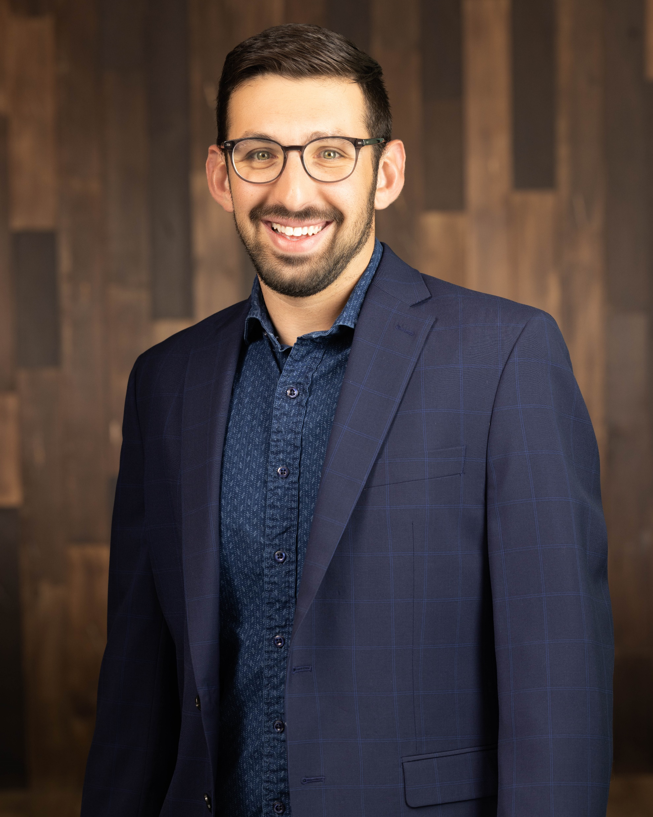
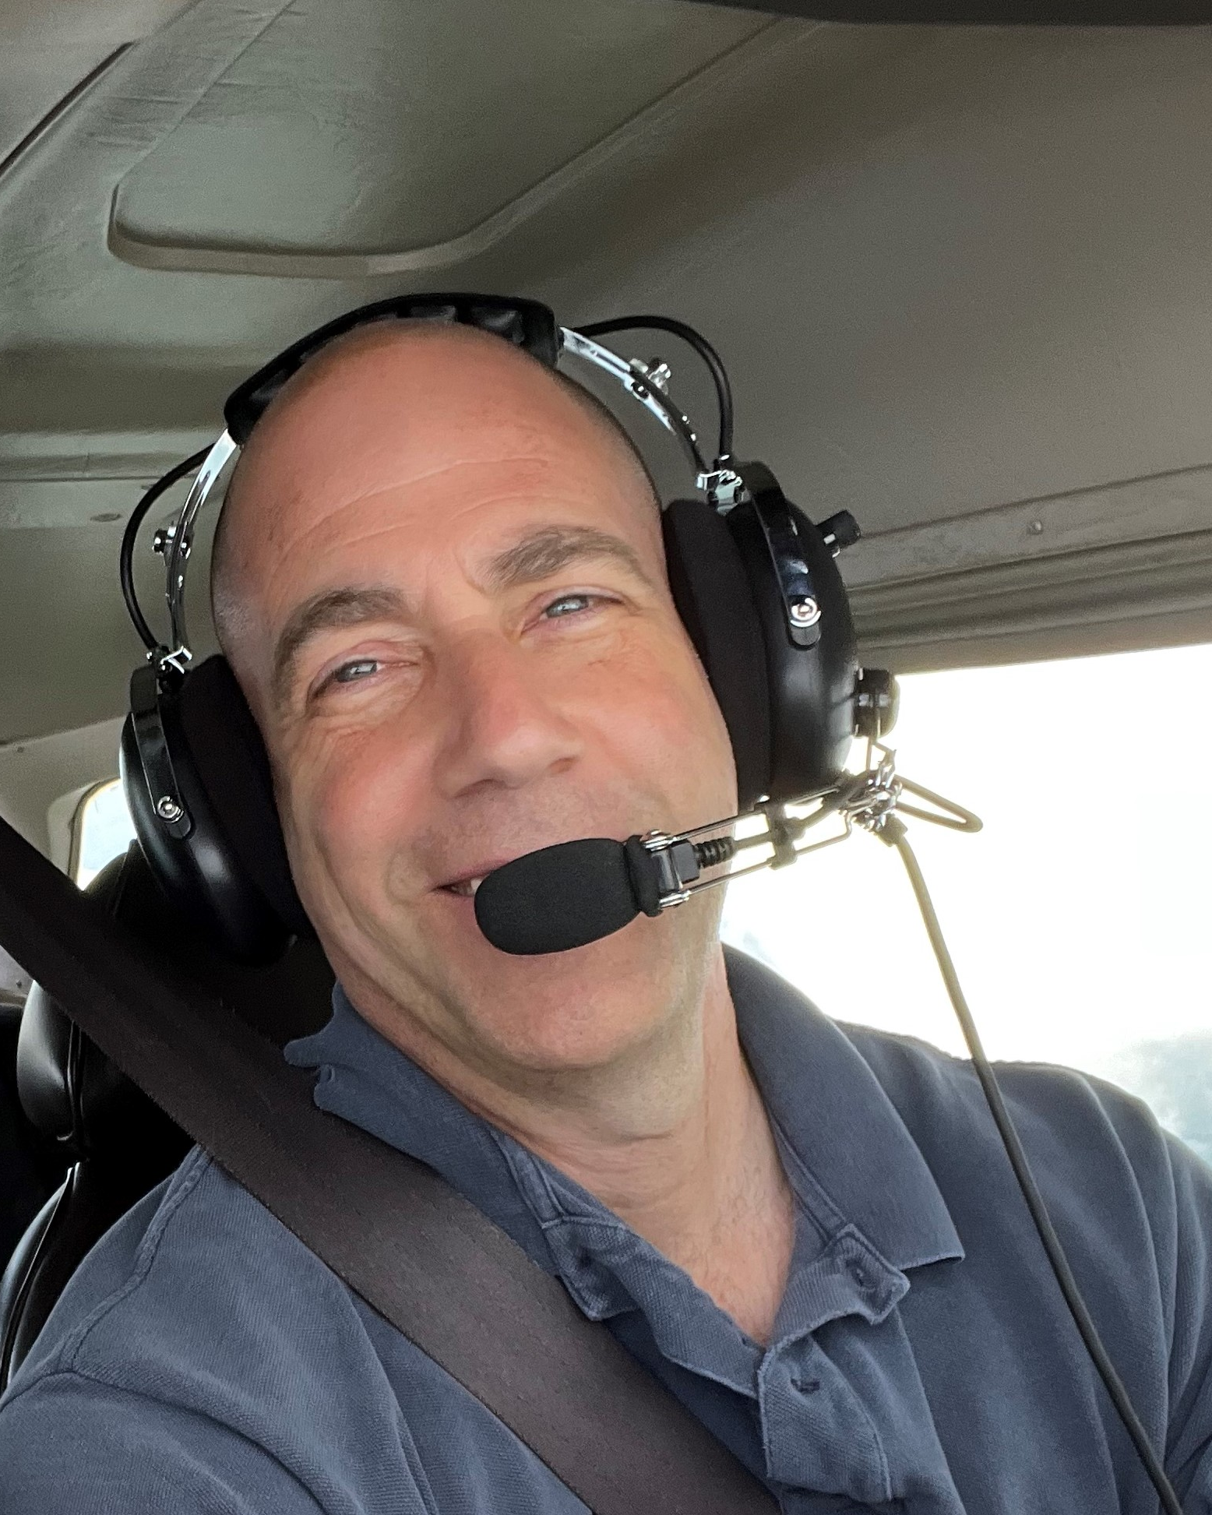
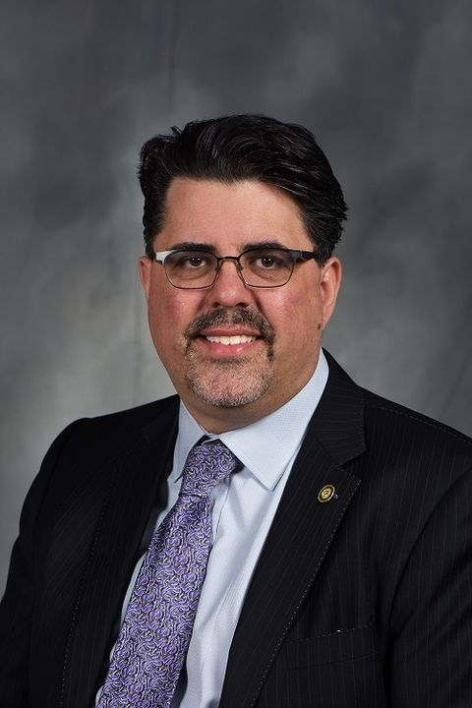
Critical Elements for AAM Success Panel
Shannetta Griffin Associate Administrator for Airports, FAA
Caitlan Flis Assistant Policy Director, Office of Ohio Governor Mike DeWine
Dr. Kelly Cohen Endowed Chair, Aerospace Engineering and Engineering Mechanics, University of Cincinnati
Zach Shuman National Aviation Services Practice Leader, Woolpert
Ethan Krimins President, Flight Profiler
Jason Lorenzon Professor of Aviation Law, Kent State University

Slide 14
2023 National Advanced Air Mobility Industry Forum Questionnaire

